Slide 1

Kan vindmølleparker påvirke havsikulasjonen og klimaet?
Göran Broström
goran.brostrom@met.no

Slide 2
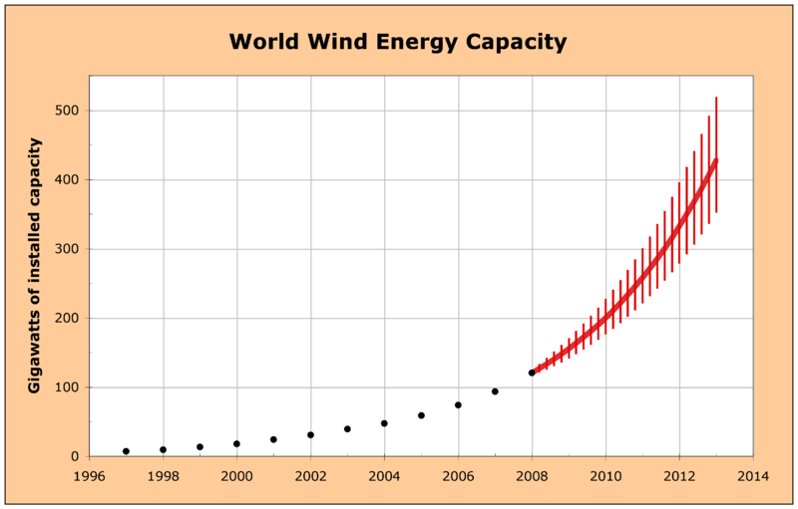
www.wikipedia.com

Slide 3
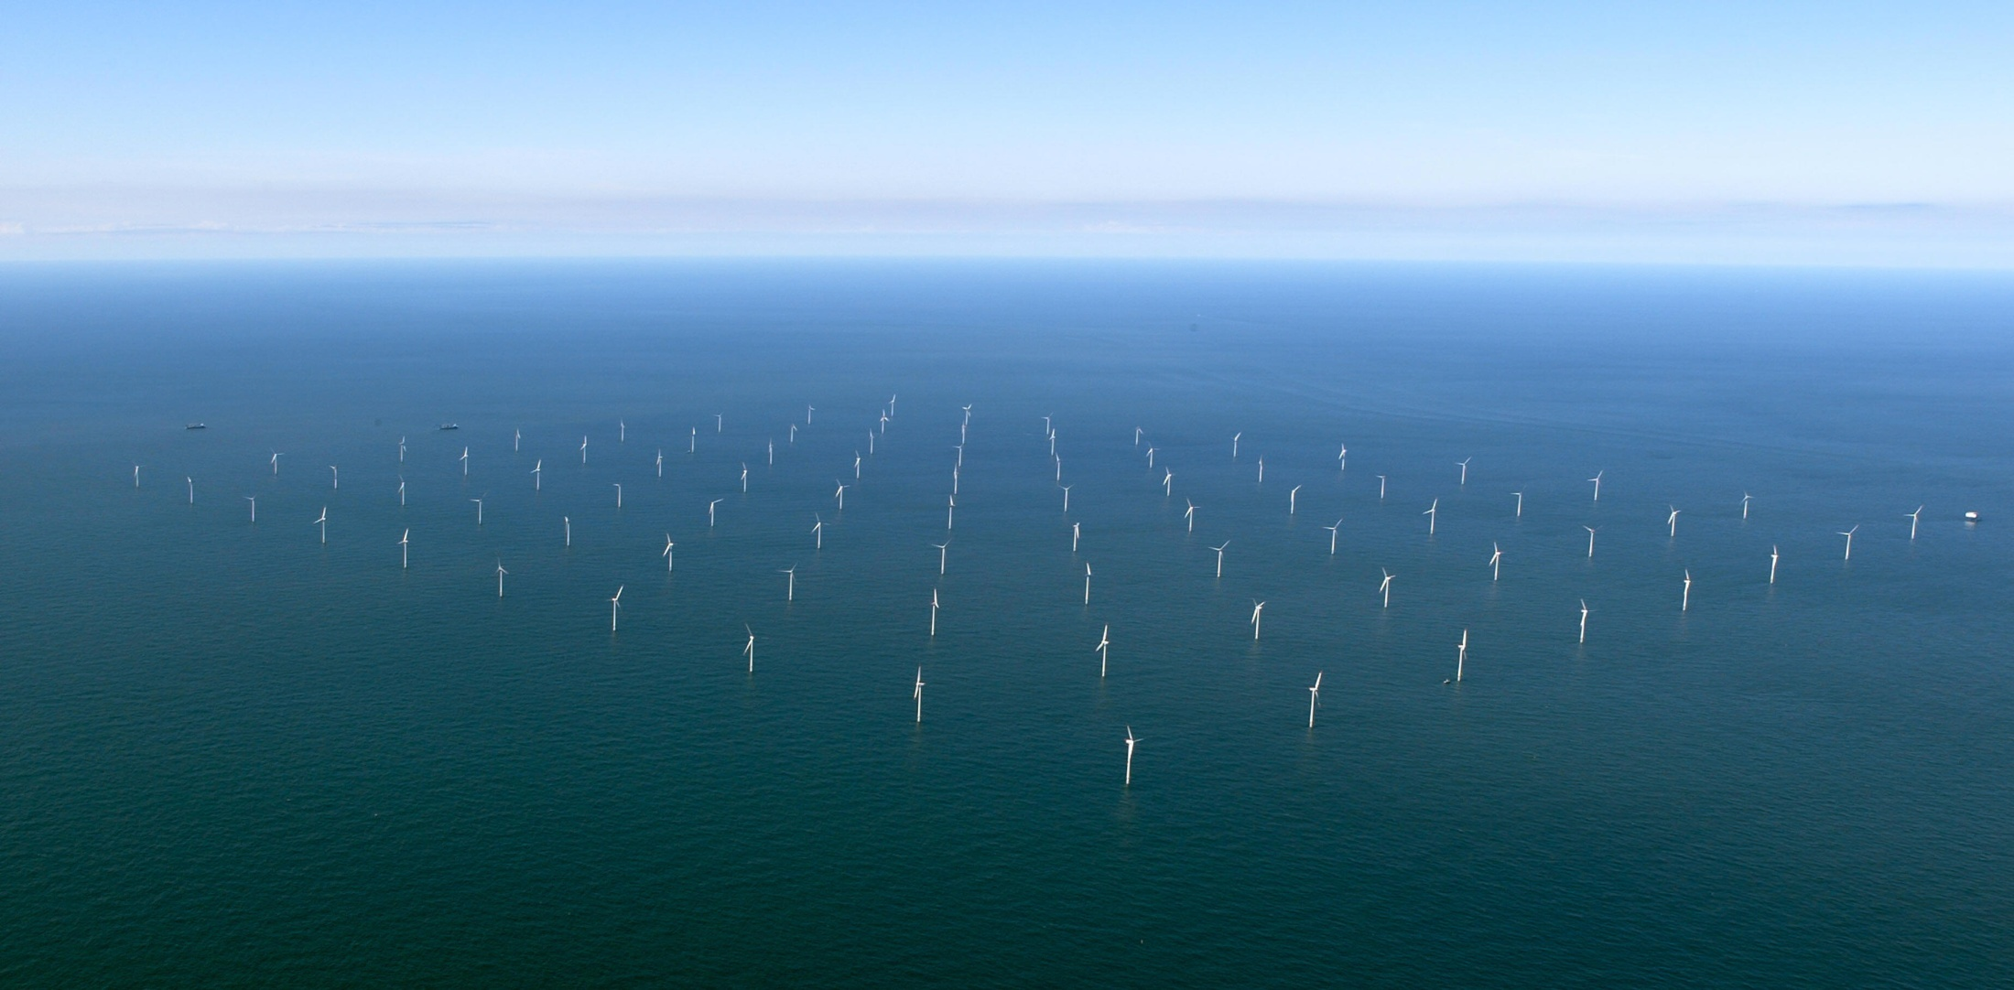
Horns rev, Danmark

Slide 4
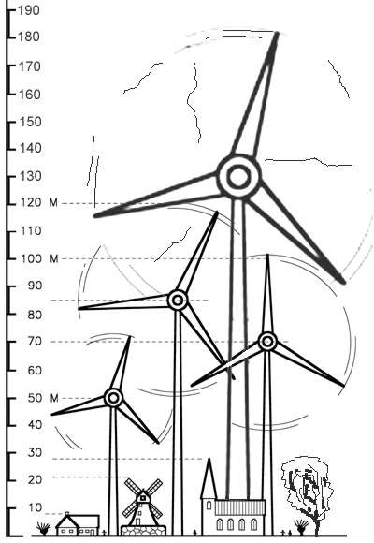

Slide 5
Notes:
Henderson et al, Wind Energy,2003, 6,35

Slide 6
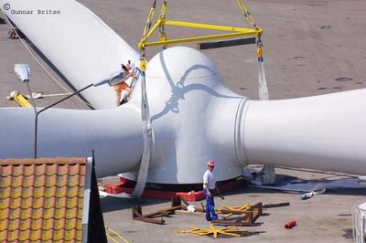

Slide 7
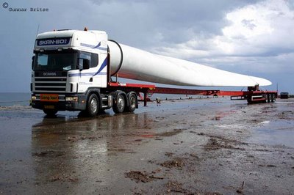

Slide 8
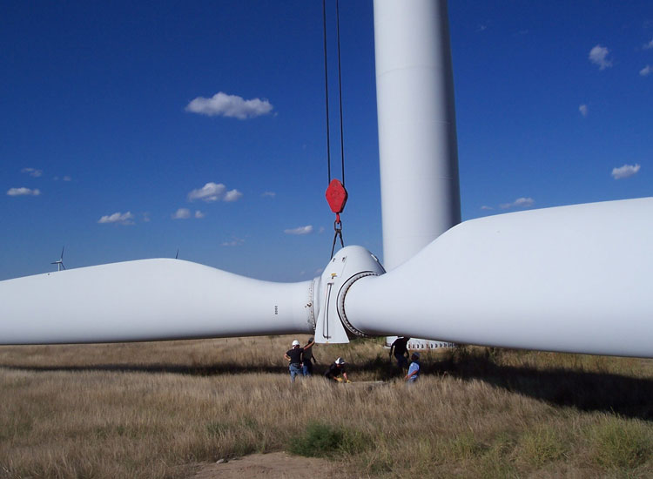

Slide 9
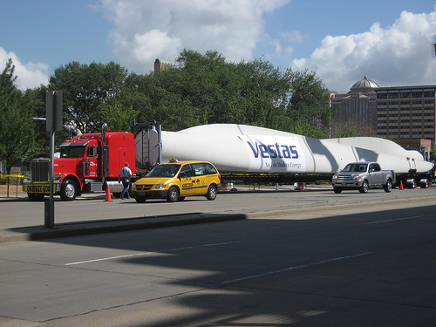

Slide 10
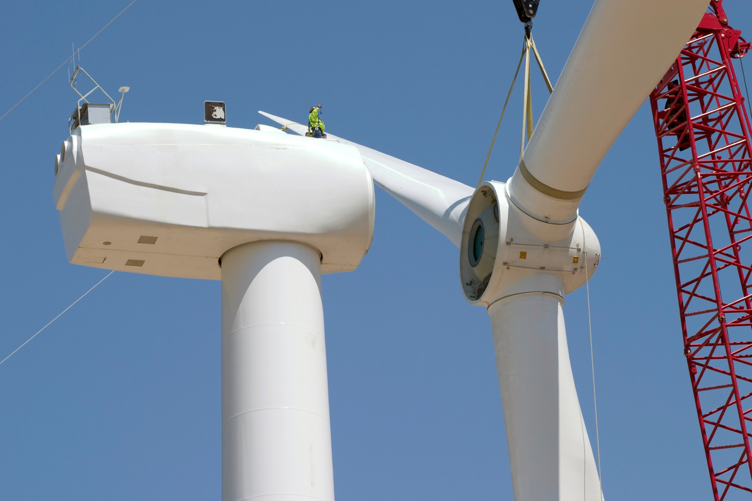

Slide 11


Slide 13
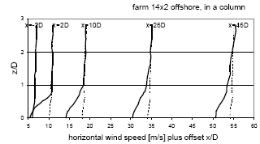
Measurement in the middle row.
Measurement between the rows.
Notes:
D=turbine diameter
Wind mills separated by 4D

Slide 14
Measurement of wind speed behind a wind farm (horns rev wind farm)
Barthelmie et al, JAOT, 2003, 20, 466-477
Notes:
Barthelmie et al, JAOT, 2003, 20, 466-477

Slide 15
Wind speed behind wind mills (at the height of the wind mill) as a function of the number of turbines

Slide 16
Flight track in an investigation focusing on the wake behind a wind farm
Study performed at Horns rev

Slide 17
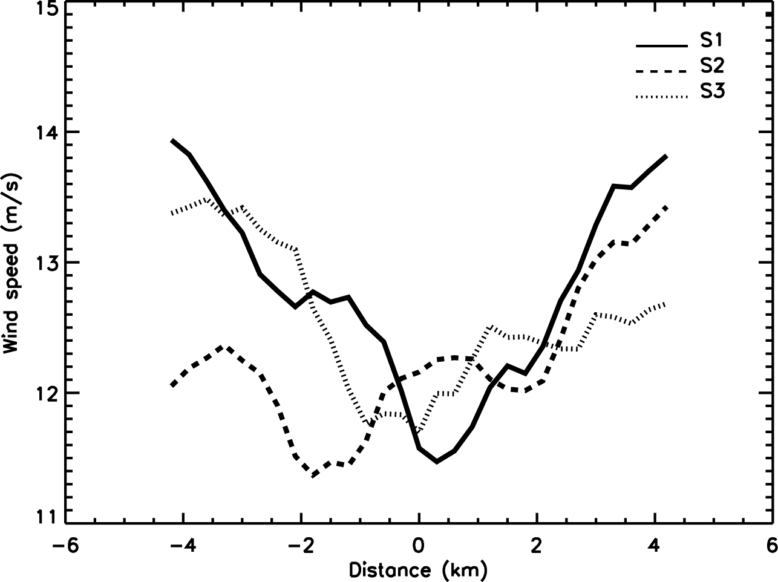
A wind decreases of 25% correspond to a 50% decrease in wind stress at the surface.

Slide 18
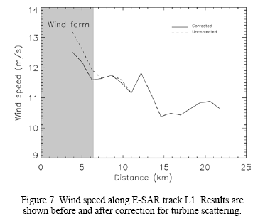

Slide 19
Turbulent Kinetic Energy
(TKE)
Is important for mixing

Slide 20
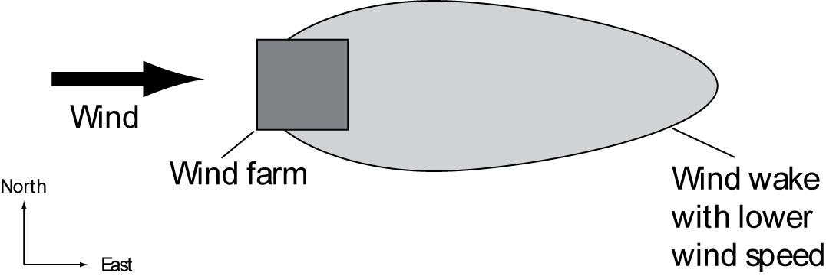
There will be lower wind speed down-wind from the wind farm

Slide 21
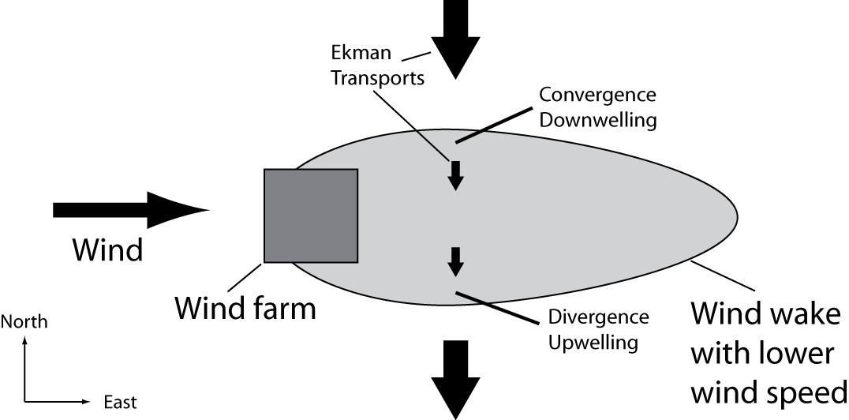

Slide 22
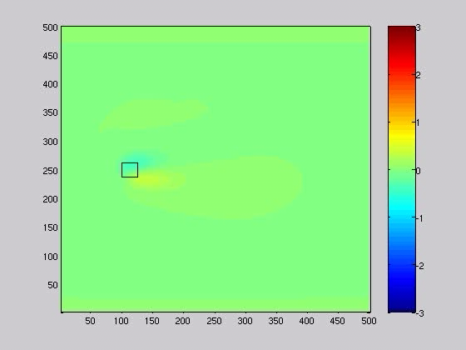

Slide 23
Example of the disturbance in ML thickness, and current vectors of the disturbance from the wind farm (wind=7.5 m/s and t=3 days)

Slide 25
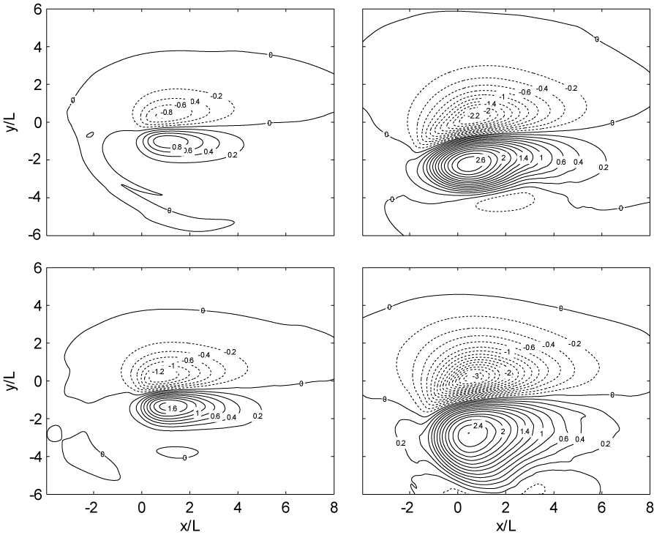
ML changes after 1 day ML changes after 5 days
Wind speed 5 m/s Wind speed 7.5 m/s

Slide 26
Strong response in ocean since wind wake size is comparable to internal radius of deformation (Internal Rossby radius).
Shallow water equations:
Gives for time scales of order f⁻¹:
Non-dim:

Slide 27
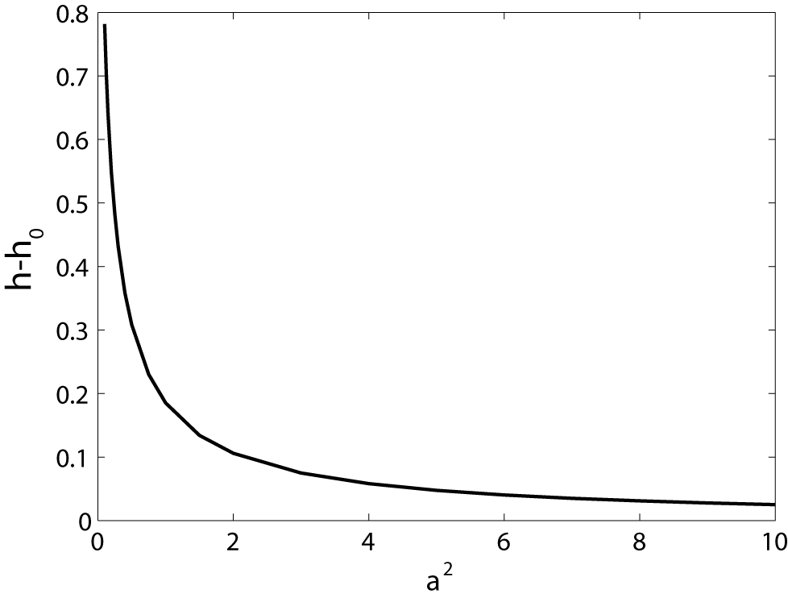

Slide 28
Guesstimating the response
L=5 km,
t=24 h,
Wind=7.5 m/s
(Δρ=2 kg/m³)
Total upwelling: 2∙10⁸ m³/day
NO₃=10 mmol/m³: 160 ton biomass C/day
Fish (1% tropic efficiency): 8 ton (herring) /day
L=10 km,
t=24 h,
Wind=7.5 m/s
(Δρ=2 kg/m³)
Total upwelling: 16∙10⁸ m³/day
NO₃=10 mmol/m³: 1280 ton biomass C/day
Fish (1% tropic efficiency): 64 ton (herring) /day

Slide 30
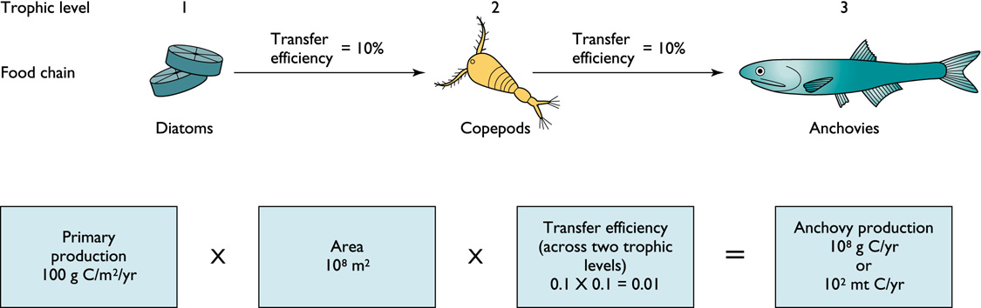

Slide 31
ML changes after 1 day ML changes after 5 days
Wind speed 5 m/s Wind speed 7.5 m/s

Slide 32
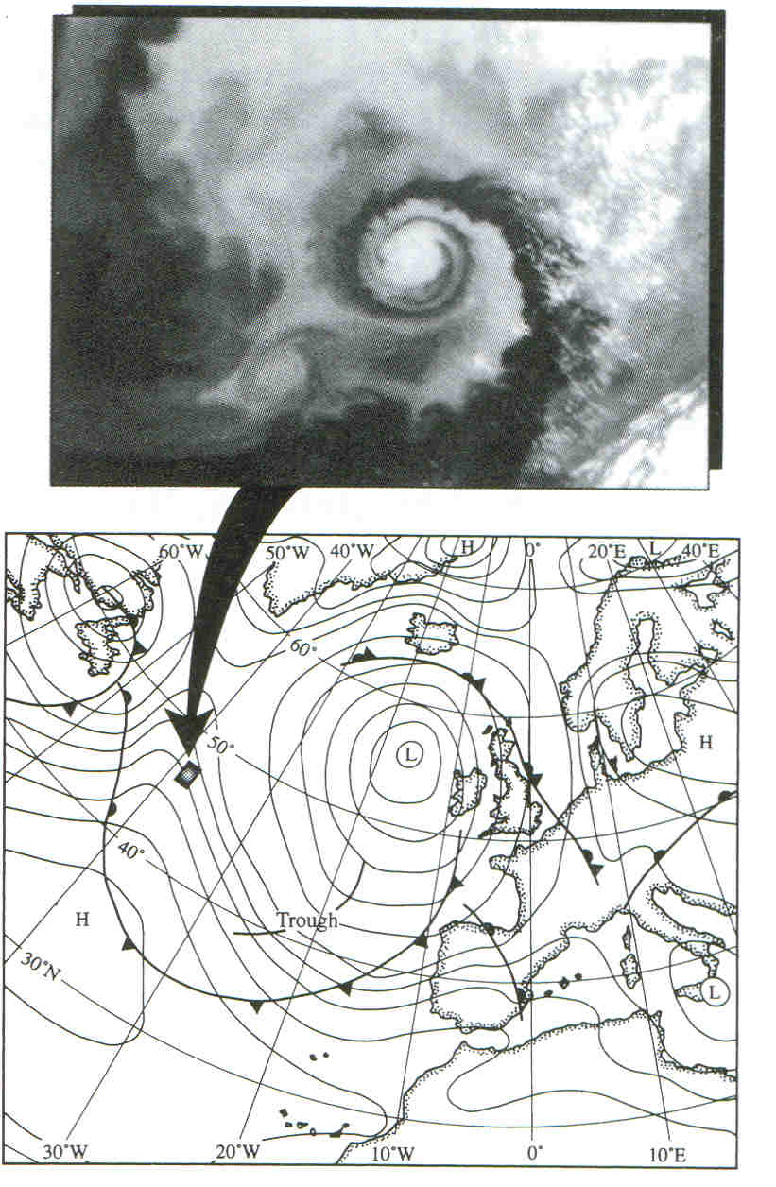
Atmosfärens lågryck och havets virvlar: Dynamiskt samma sak men helt olika!

Slide 33
Notes:
Fig. 4. Wind speed map based on subsection (50 km by 50 km) of the ERS-
2 SAR scene of 21 December 2003. The wind farm at Horns Rev is
indicated (white trapezoid) and the submerged reef is visible. Wind
direction=97-, wind speed=8.8 m s1 from mast.

Slide 34
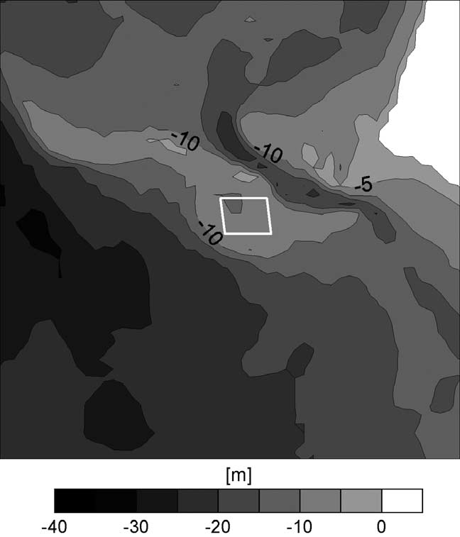
Notes:
Fig. 5. Bathymetry map covering the area of the SAR image in Fig. 4. The
wind farm at Horns Rev is indicated (white trapezoid). Courtesy DHI/
Fig. 5. Bathymetry map covering the area of the SAR image in Fig. 4. The
wind farm at Horns Rev is indicated (white trapezoid). Courtesy DHI/
50395/2.ed.Nov 2001/PH/KAE.

Slide 35
Impact on atmosphere

Slide 36
Results from a large wind farm in the US midwest:: Located on a position with a strong nocturnal jet.
Scenario1: Only wind influence
Scenario 2: influence on both wind and turbulent kinetic energy (mixing)

Slide 37
Global effect on climate
These values were chosen to represent an array of wind turbines, 2.8 turbines per km², each with 100-m-diameter rotors and 100-m hubheights that remove 40% of kinetic energy of the resolved flow.
(about 2 TW wind energy)
NCAR model
B) GFDL model
Keith, D.W. et al., 2004. The influence of large-scale wind power on global climate. Proceeding of the National Academy of Science, 101: 16115-16120.

Slide 38
“climate” impact
Broström, 2008, On the influence of large wind farms on the upper ocean circulation. Journal of Marine Systems,,
  Potential strong affect on the upwelling in the ocean. Local current systems may be created.
Baidya Roy, S. and Pacala, S.W., 2004. Can large wind farms affect local meteorology? Journal of Geophysical Research, 109: D19101, doi:10.1029/2004JD004763.
  The local affect (within the farm) from large wind farms cannot be neglected.
Rooijmans, P., 2004. Impact of a large-scale offshore wind farm on meteorology. Ms Thesis, Utrecht University, Utrecht.
  Using large wind farms (100*90 km) he concluded that wind farms affect cloudiness and precipitation.
Keith, D.W. et al., 2004. The influence of large-scale wind power on global climate. Proceeding of the National Academy of Science, 101: 16115-16120.
  Global climate influence of continental scale wind farms
Kirk-Davidoff, D.B., and Keith, D.W., 2008, On the climate impact of surface roughness anomalies. J. Atmos. Sci., 85, 2215-2234, doi:10.1175/2007JAS2509.1.
  Studies how changes in roughness length impacts on the large scale circulation
Barrie, D.B., and Kirk-Davidoff, D.B., 2009. Weather response to management of a large wind turbine array. Atmos. Chem. Phys. Discuss., 9, 2917-2913.
  Discuss the possibility to control weather by managing the wind farm. State that it should be possible to invoke control on some aspects of weather.

